Slide 1
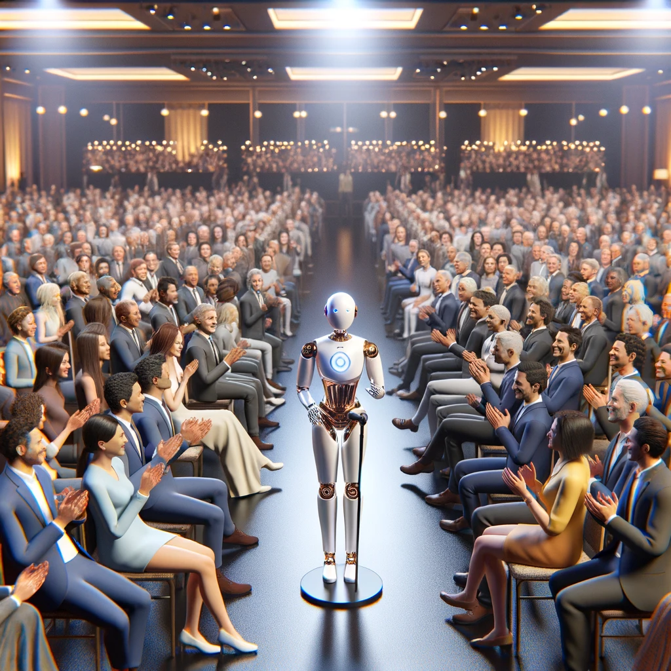
Using Zoom AI Companion with Sessions & Events Part 7

Slide 2

“My favorite game on Zoom is ‘Spot the awkward virtual background’. It’s like a virtual scavenger hunt!”

Slide 3




Notes:
https://www.youtube.com/channel/UC35ZpwldGw7ZJ5R-2sLijzw

Slide 4
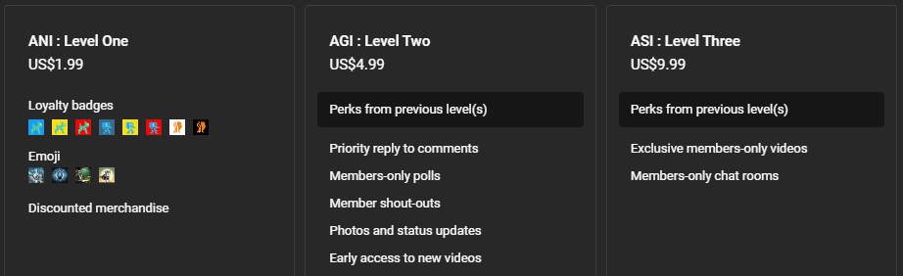

Membership has its privileges
Notes:
https://www.youtube.com/channel/UC35ZpwldGw7ZJ5R-2sLijzw/join

Slide 5
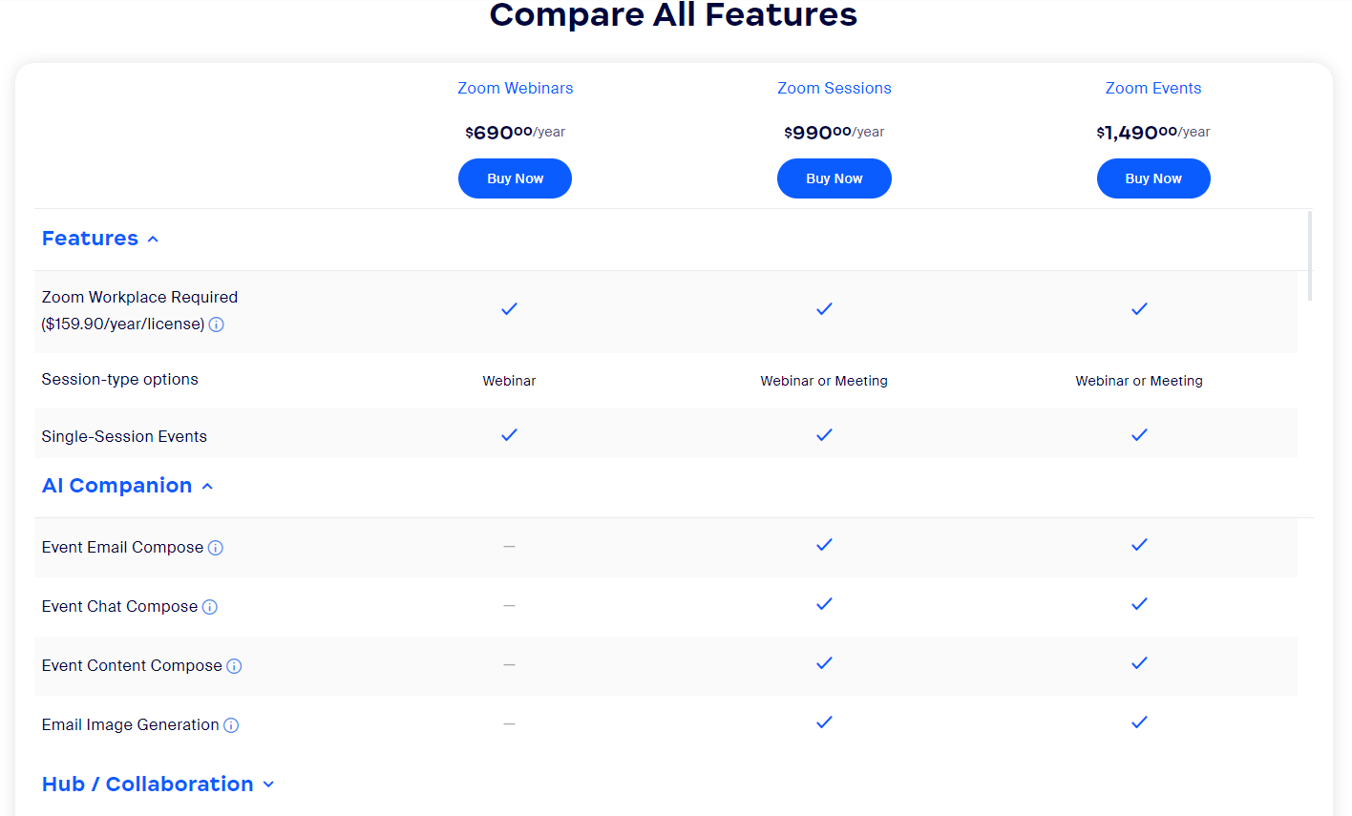

Slide 6
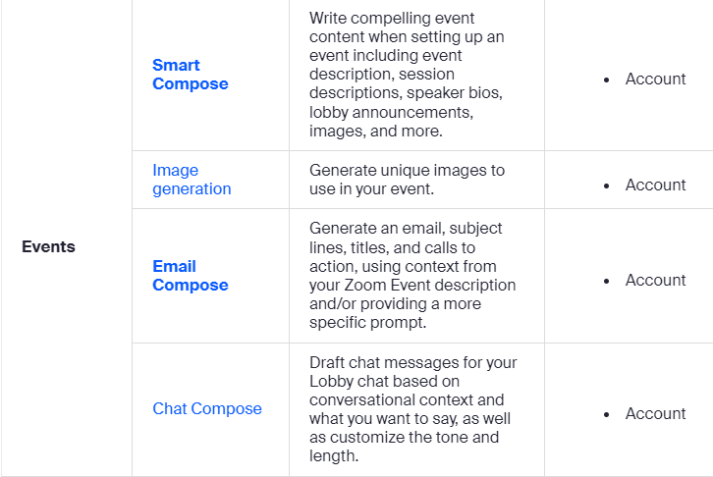

Slide 7

Image Generation
Notes:
https://support.zoom.com/hc/en/article?id=zm_kb&sysparm_article=KB0073761

Slide 8
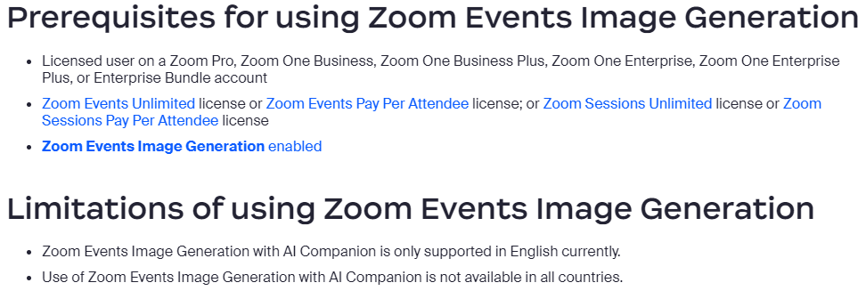

Slide 9
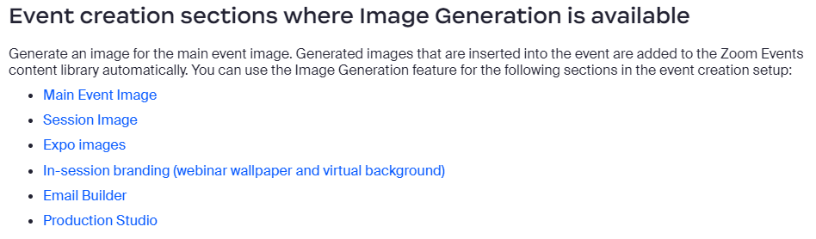

Slide 10
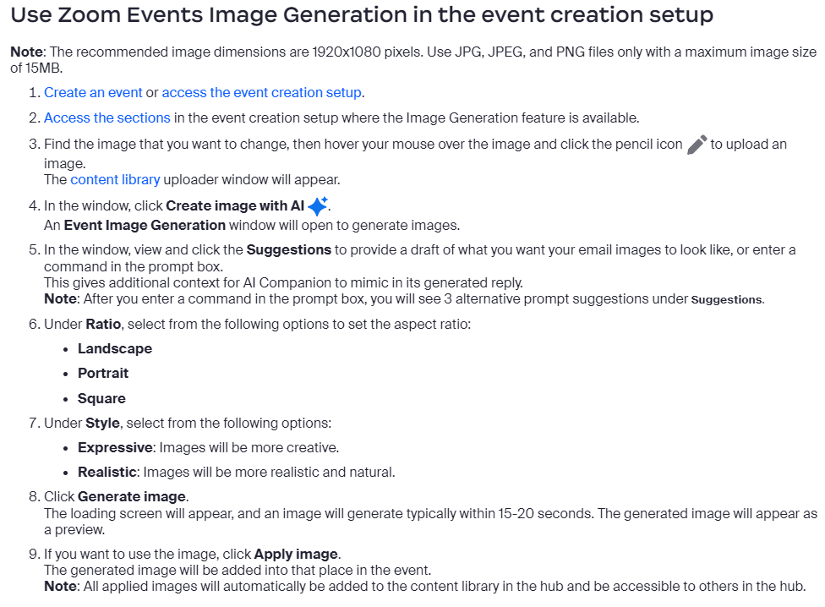

Slide 11
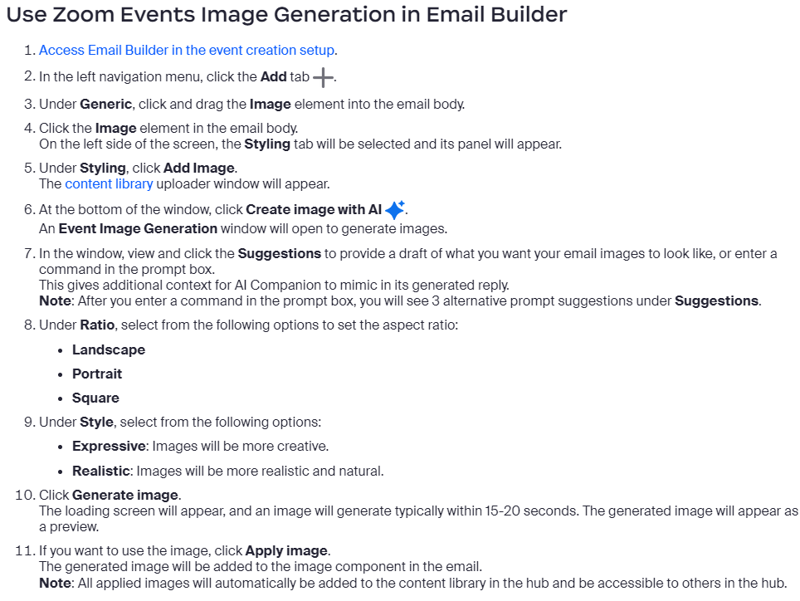

Slide 12
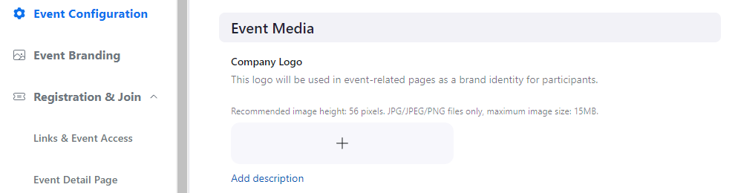
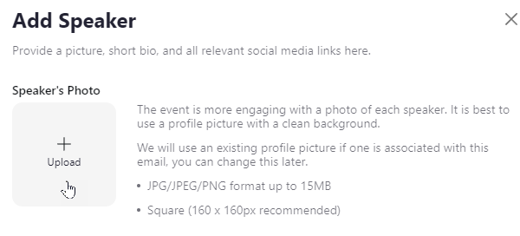
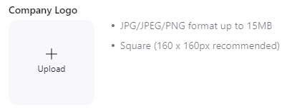
Demo: Image Generation

Slide 13

Smart Compose

Slide 14
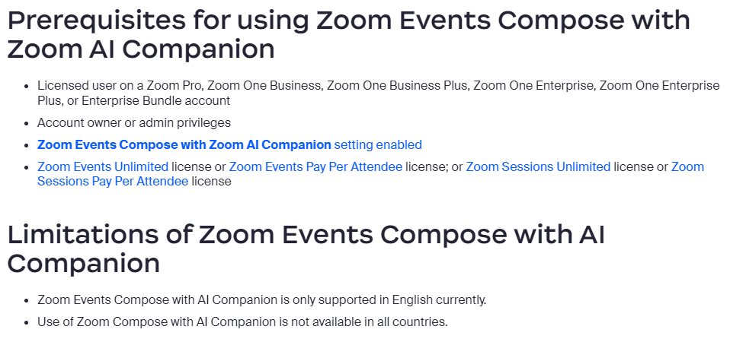

Slide 15
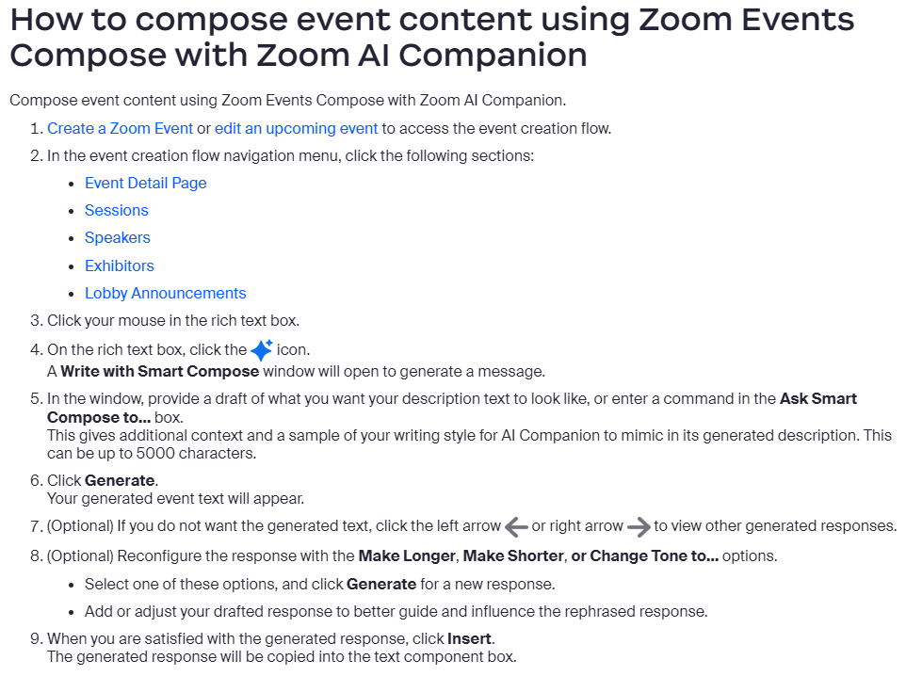

Slide 16
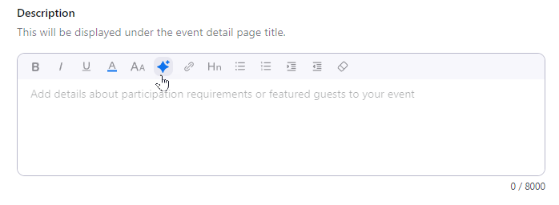
Demo: Zoom Events Compose

Slide 17
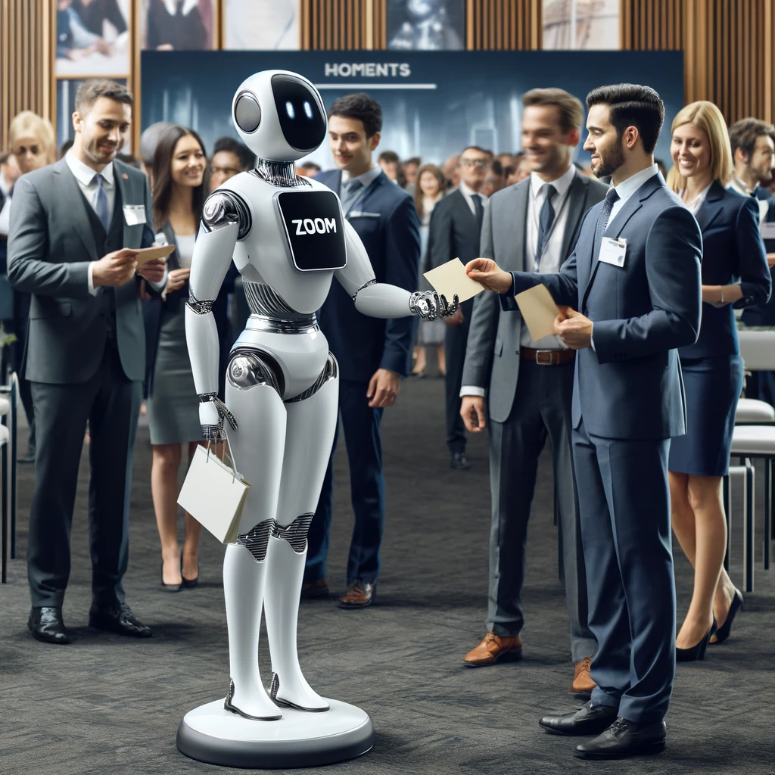
Email Compose
Notes:
https://support.zoom.com/hc/en/article?id=zm_kb&sysparm_article=KB0010218

Slide 18
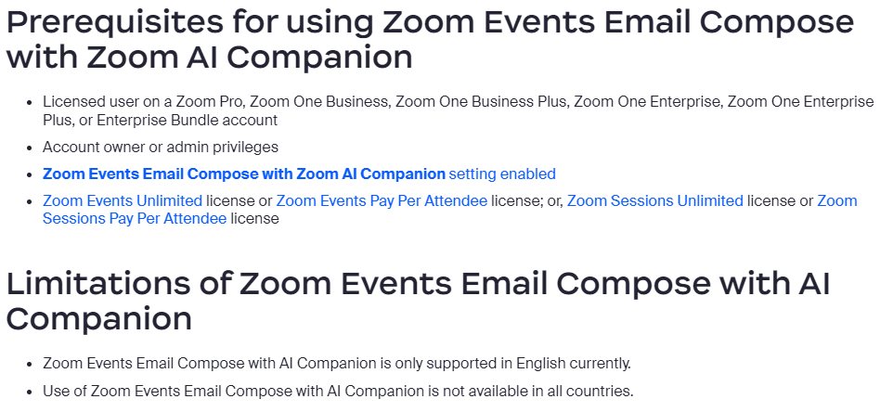

Slide 19
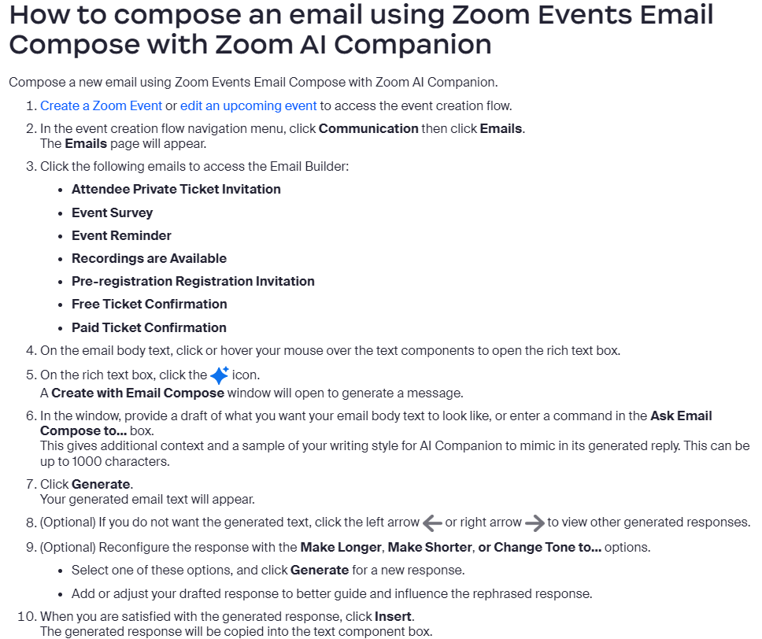

Slide 20
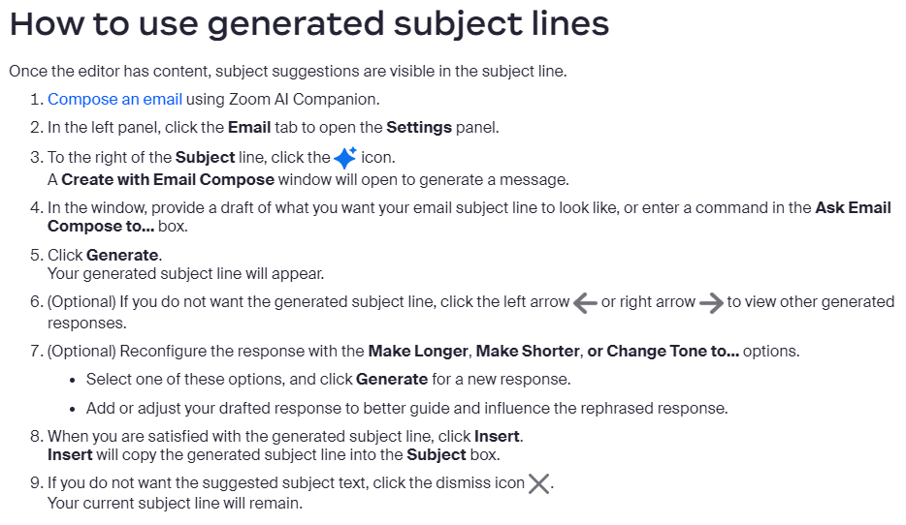

Slide 21
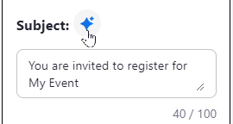
Demo: Email Compose

Slide 22

Lobby Chat
Notes:
https://support.zoom.com/hc/en/article?id=zm_kb&sysparm_article=KB0057558

Slide 23
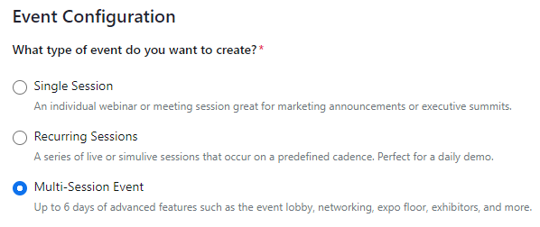

Slide 24
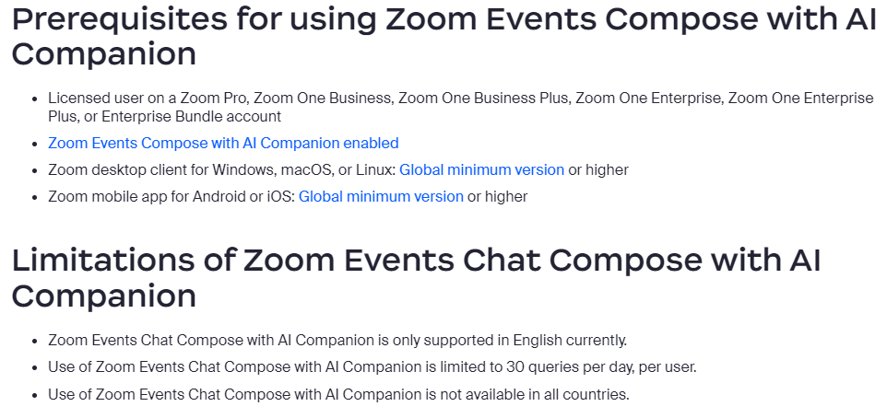

Slide 25
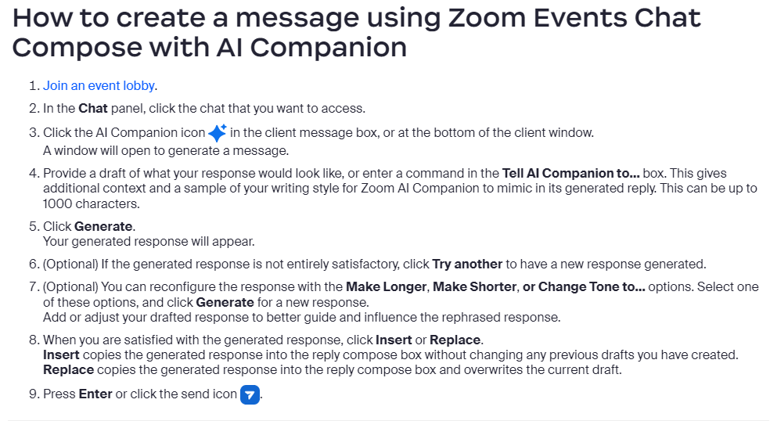

Slide 26
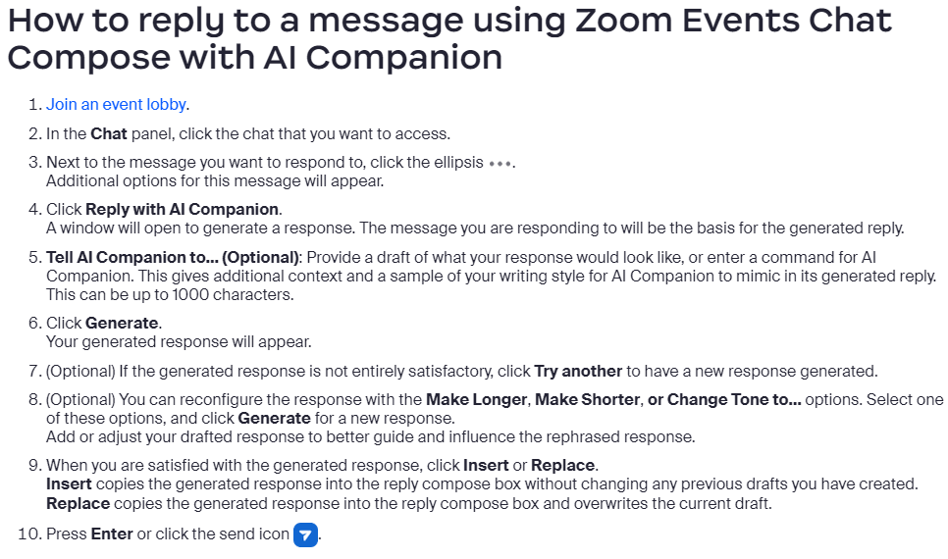

Slide 27
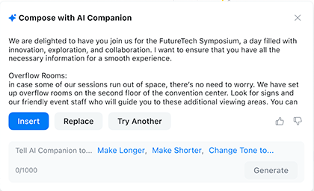
Demo: Lobby Chat

Slide 28
